Slide 1
Stock Prediction Tool
By Zihao Justin Huang
5/7/2019

Slide 2
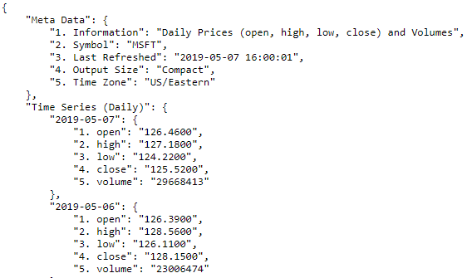
Data Collection
Data was collected from Alpha Vantage API, a replacement of Yahoo stocks API that was shut down in 2017
Daily stock prices are returned as Json format as shown below

Slide 3
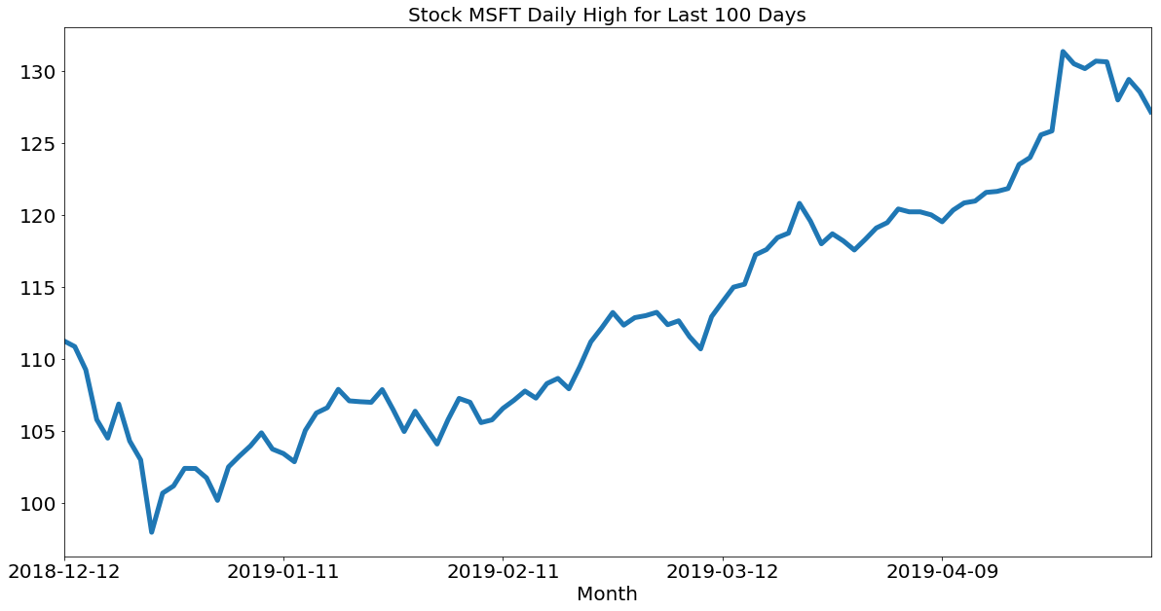
Data Exploration

Slide 4
Project Proposal
Create a tool that helps user to predict the stock price in the next 7 days
Based on the time series data, run a ARIMA model to forecast the selected stock price in the next 7 days
User should be able to enter the stock he/she is interested, the tool should returned a plot showing the last 100 days’ stock prices plus the 7 days forecast, additionally some summary and prediction accuracy information would be shown to provide user confidence of the tool

